Slide 1
CDI Resolución de Ejercicios

Slide 2
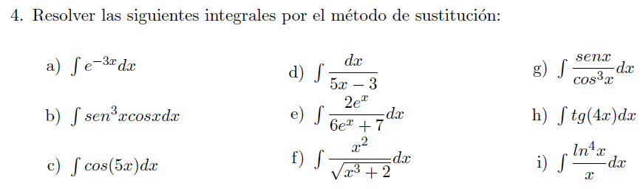

Slide 3


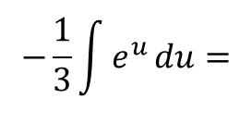



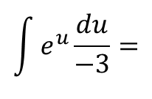
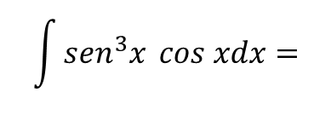


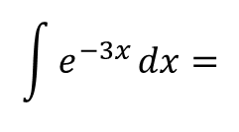

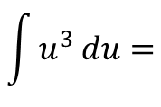
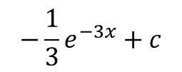

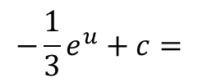

$$\int{e^{−3x}}dx=$$
$$\int{e^{u}}\frac{du}{−3}=$$
$$−\frac{1}{3}\int{e^{u}}du=$$
$$−\frac{1}{3}e^{u}+c=$$
$$−\frac{1}{3}e^{−3x}+c$$
$$u=−3x$$
$$du=−3 dx$$
$$\frac{du}{−3}=dx$$
$$\int{{sen}^{3}x }cos xdx=$$
$$\int{u^{3}}du=$$
$$\frac{u^{4}}{4}+c=$$
$$\frac{{(sen x)}^{4}}{4}+c=$$
$$\frac{1}{4}{sen}^{4}x+c$$
$$u=sen x$$
$$du=\cos{x}dx$$

Slide 4

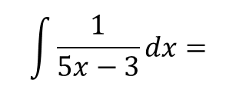

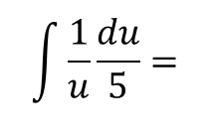
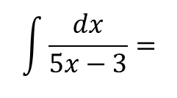


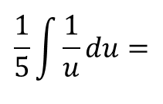


$$\int{\frac{dx}{5x−3}}=$$
$$\int{\frac{1}{5x−3}}dx=$$
$$\int{\frac{1}{u}}\frac{du}{5}=$$
$$\frac{1}{5}\int{\frac{1}{u}}du=$$
$$\frac{1}{5}\ln{u}+c=$$
$$\frac{1}{5}\ln{(5x−3)}+c$$
$$u=5x−3$$
$$du=5 dx$$
$$\frac{du}{5}=dx$$

Slide 5

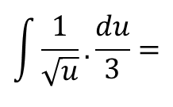


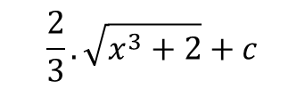
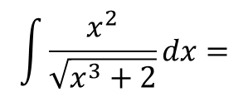


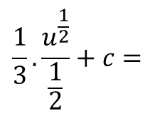

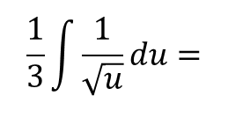
$$\frac{1}{3}.\frac{u^{\frac{1}{2}}}{\frac{1}{2}}+c=$$
$$\int{\frac{x^{2}}{\sqrt{x^{3}+2}}}dx=$$
$$\int{\frac{1}{\sqrt{x^{3}+2}}}.x^{2}dx=$$
$$\int{\frac{1}{\sqrt{u}}}. \frac{du}{3}=$$
$$\frac{1}{3}\int{\frac{1}{\sqrt{u}}}du=$$
$$u=x^{3}+2$$
$$=\frac{2}{3}.\sqrt{u}+c=$$
$$\frac{2}{3}.\sqrt{x^{3}+2}+c$$
$$du={3x}^{2}dx$$
$$\frac{du}{3}=x^{2}dx$$

Slide 6


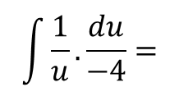
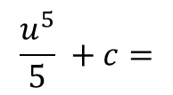

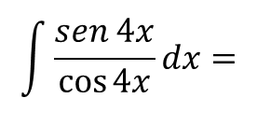
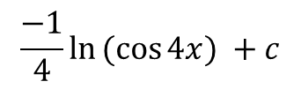
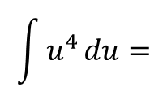
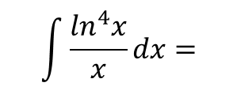
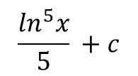
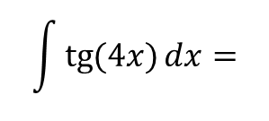
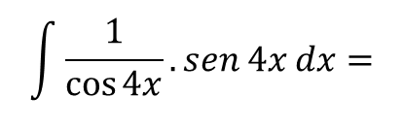



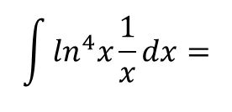

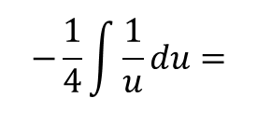

$$\int{\operatorname{tg}{(4x)}}dx=$$
$$\int{\frac{sen 4x}{\cos{4x}}}dx=$$
$$\int{\frac{1}{\cos{4x}}.sen 4x}dx=$$
$$\int{\frac{1}{u}}. \frac{du}{−4}=$$
$$−\frac{1}{4}\int{\frac{1}{u}}du=$$
$u=$ $\cos{4x}$
$$du=−4.sen 4xdx$$
$$=\frac{−1}{4}\ln{u} +c=$$
$$\frac{−1}{4}\ln{(cos{4x)}} +c$$
$$\frac{du}{−4}=sen 4xdx$$
$$\int{\frac{\ln^{4}x}{x}}dx=$$
$$\int{\ln^{4}x}\frac{1}{x}dx=$$
$$\int{u^{4}}du=$$
$$\frac{u^{5}}{5} +c=$$
$$\frac{\ln^{5}x}{5} +c$$
$$u=\ln{x}$$
$$du=\frac{1}{x}dx$$

Slide 7

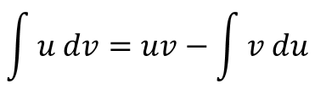



Integral por Partes
$$\int{u dv=uv−\int{v du}}$$
Se tiene cuatro expresiones por determinar:
$$u$$
$$dv$$
$$du$$
$$v$$
Para determinar a que función vamos a llamar “u” utilizamos un criterio de selección (no es único):
LIPET
L: logarítmica
I: inversas
P: potencias
E: exponenciales
T: trigonométricas

Slide 8
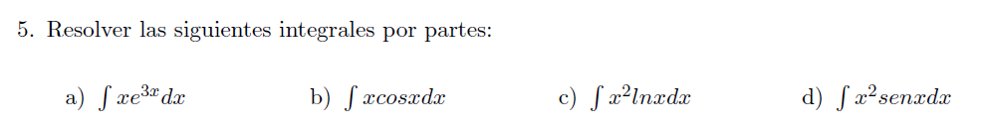









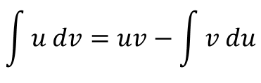
$$\int{u dv=uv−\int{v du}}$$

Slide 9







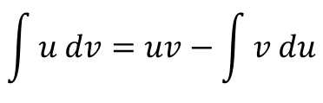
$$\int{u dv=uv−\int{v du}}$$

Slide 10











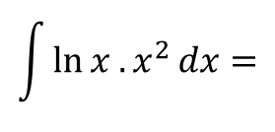
$$\int{u dv=uv−\int{v du}}$$
$$\int{\ln{x . x^{2}}}dx=$$

